Slide 1
12
Object-Oriented
Programming:
Inheritance

Slide 2
OBJECTIVES
In this chapter you will learn:
To create classes by inheriting from existing classes.
How inheritance promotes software reuse.
The notions of base classes and derived classes and the relationships between them.
The protected member access specifier.
The use of constructors and destructors in inheritance hierarchies.
The differences between public, protected and private inheritance.
The use of inheritance to customize existing software.

Slide 3
12.1 Introduction
12.2 Base Classes and Derived Classes
12.3 protected Members
12.4 Relationship between Base Classes and Derived Classes
12.4.1 Creating and Using a CommissionEmployee Class
12.4.2 Creating a BasePlusCommissionEmployee Class Without Using Inheritance
12.4.3 Creating a CommissionEmployee-BasePlusCommissionEmployee Inheritance Hierarchy
12.4.4 CommissionEmployee-BasePlusCommissionEmployee Inheritance Hierarchy Using protected Data
12.4.5 CommissionEmployee-BasePlusCommissionEmployee Inheritance Hierarchy Using private Data
12.5 Constructors and Destructors in Derived Classes
12.6 public, protected and private Inheritance
12.7 Software Engineering with Inheritance
12.8 Wrap-Up

Slide 4
12.1 Introduction
Inheritance
  Software reusability
  Create new class from existing class
    Absorb existing class’s data and behaviors
    Enhance with new capabilities
  Derived class inherits from base class
    Derived class
      More specialized group of objects
      Behaviors inherited from base class
        Can customize
      Additional behaviors

Slide 5
12.1 Introduction (Cont.)
Abstraction
  Focus on commonalities among objects in system
“is-a” vs. “has-a”
  “is-a”
    Inheritance
    Derived class object can be treated as base class object
    Example: Car is a vehicle
      Vehicle properties/behaviors also apply to a car
  “has-a”
    Composition
    Object contains one or more objects of other classes as members
    Example: Car has a steering wheel

Slide 6
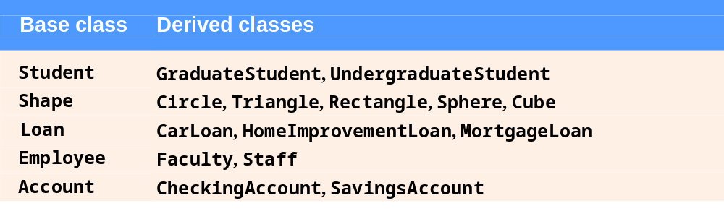
Fig. 12.1 | Inheritance examples.

Slide 7
12.2 Base Classes and Derived Classes (Cont.)
Inheritance hierarchy
  Inheritance relationships: tree-like hierarchy structure
  Each class becomes
    Base class
      Supplies data/behaviors to other classes
    OR
    Derived class
      Inherits data/behaviors from other classes

Slide 8
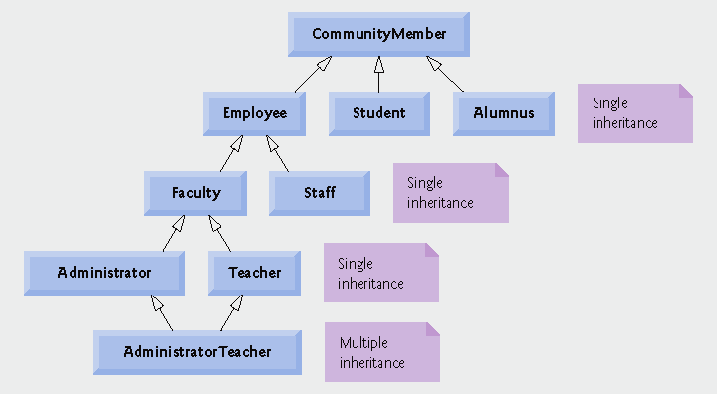
Fig. 12.2 | Inheritance hierarchy for university CommunityMembers.

Slide 9
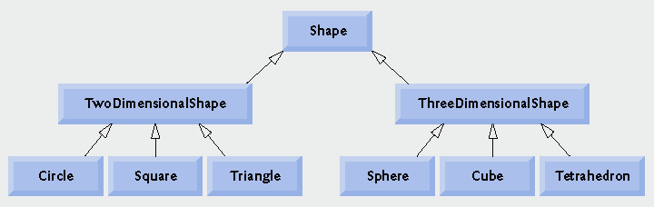
Fig. 12.3 | Inheritance hierarchy for Shapes.

Slide 10
12.2 Base Classes and Derived Classes (Cont.)
public inheritance
  Specify with:
  Class TwoDimensionalShape : public Shape
    Class TwoDimensionalShape inherits from class Shape
  Base class private members
    Not accessible directly
    Still inherited
      Manipulated through inherited public member functions
  Base class public and protected members
    Inherited with original member access
  friend functions
    Not inherited

Slide 11
12.3 protected Members
protected access
  Intermediate level of protection between public and private
  protected members are accessible to
    Base class members
    Base class friends
    Derived class members
    Derived class friends
Derived-class members
  Refer to public and protected members of base class
    Simply use member names
  Redefined base class member functions can be accessed by using base-class name and binary scope resolution operator (::)

Slide 12
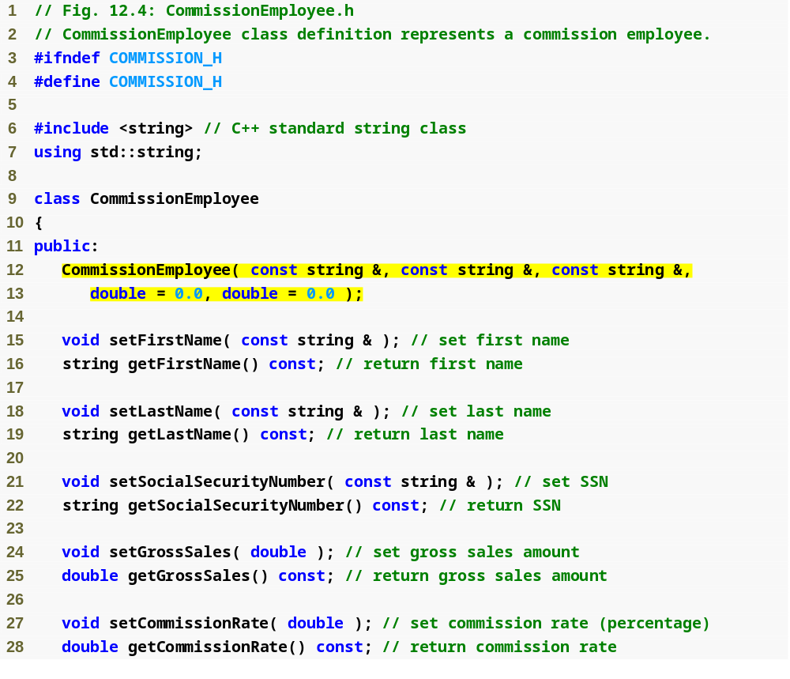
Outline
Commission
Employee.h
(1 of 2)
Class CommissionEmployee constructor

Slide 13
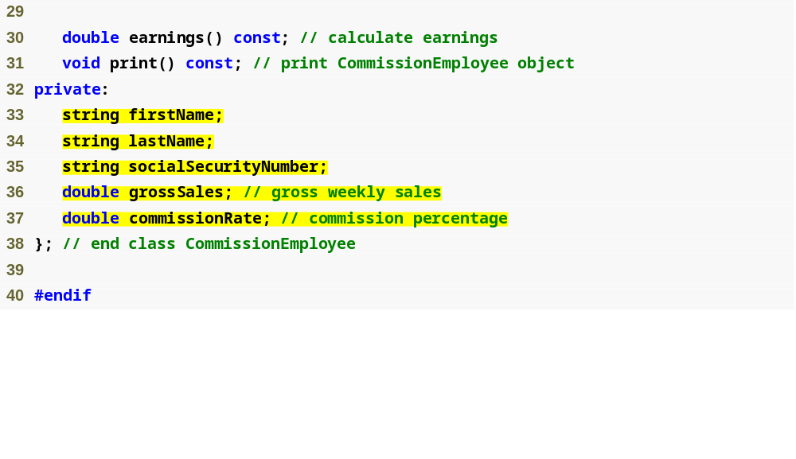
Outline
Declare private data members
Commission
Employee.h
(2 of 2)

Slide 14
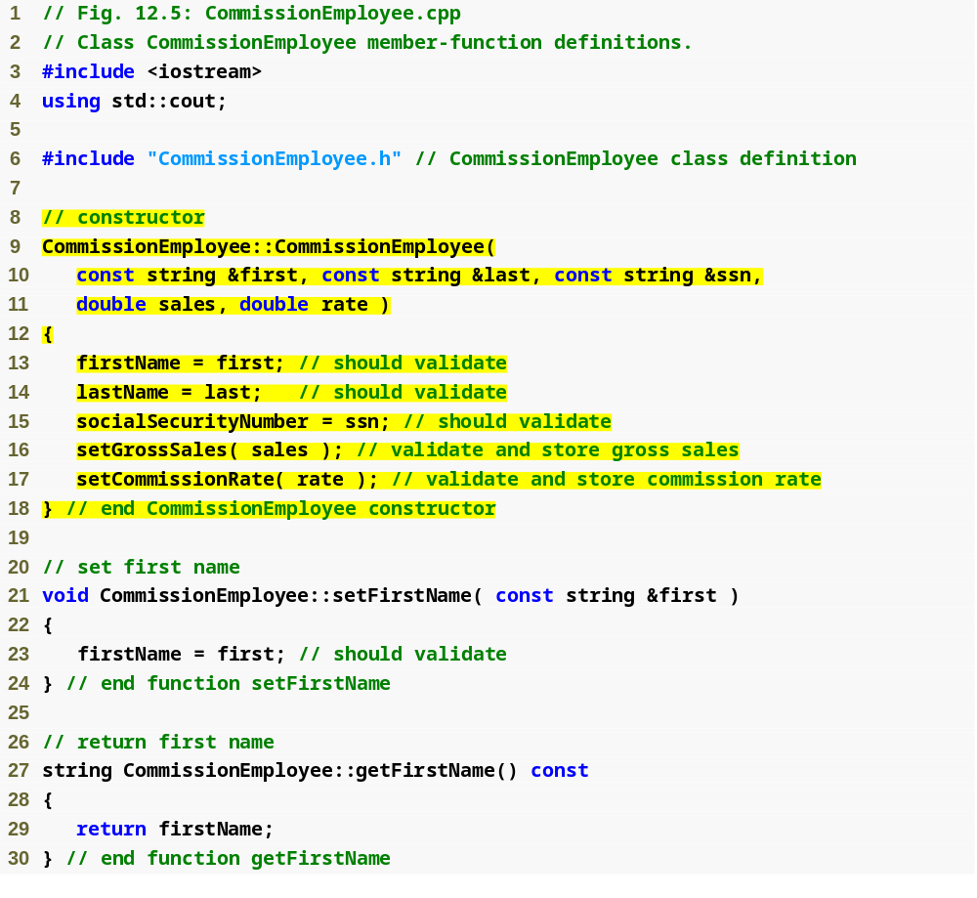
Outline
Commission
Employee.cpp
(1 of 4)
Initialize data members

Slide 15
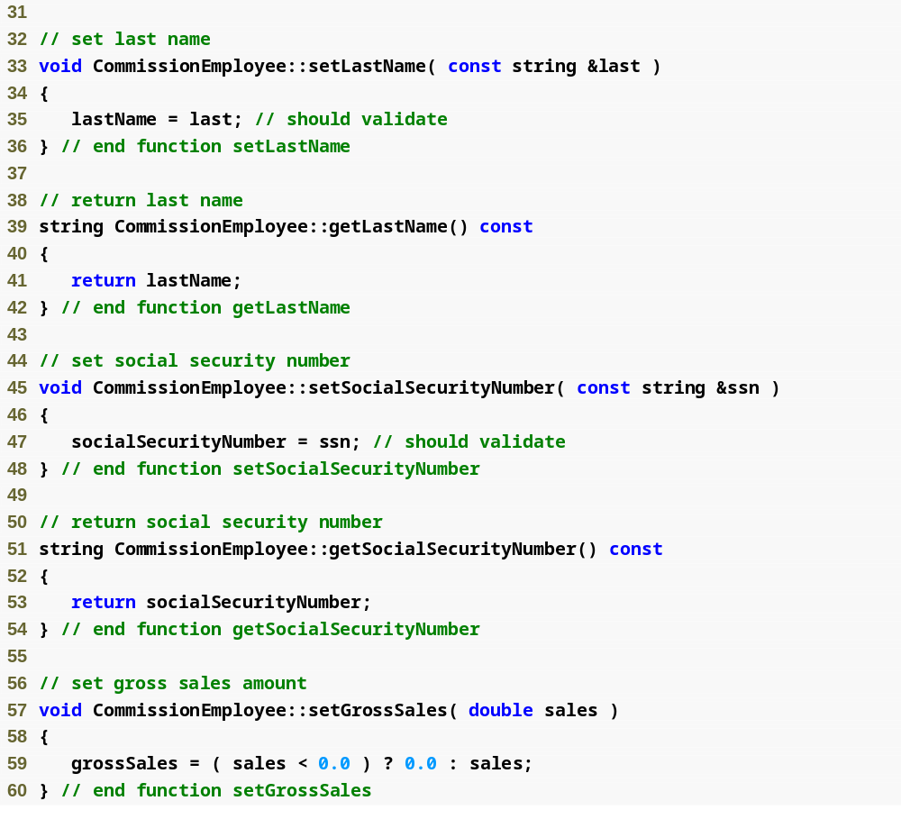
Outline
Commission
Employee.cpp
(2 of 4)
Function setGrossSales validates gross sales amount

Slide 16
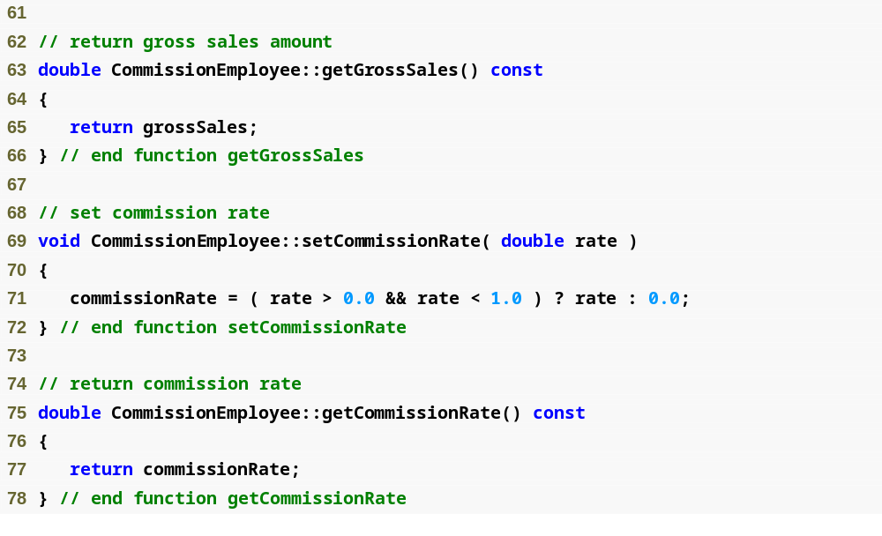
Outline
Function setCommissionRate validates commission rate
Commission
Employee.cpp
(3 of 4)

Slide 17
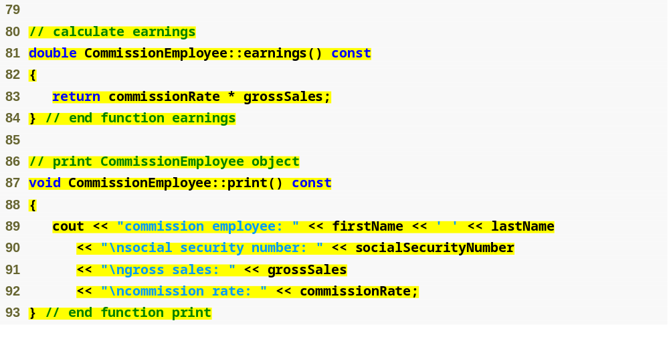
Outline
Function earnings calculates earnings
Commission
Employee.cpp
(4 of 4)
Function print displays CommissionEmployee object

Slide 18
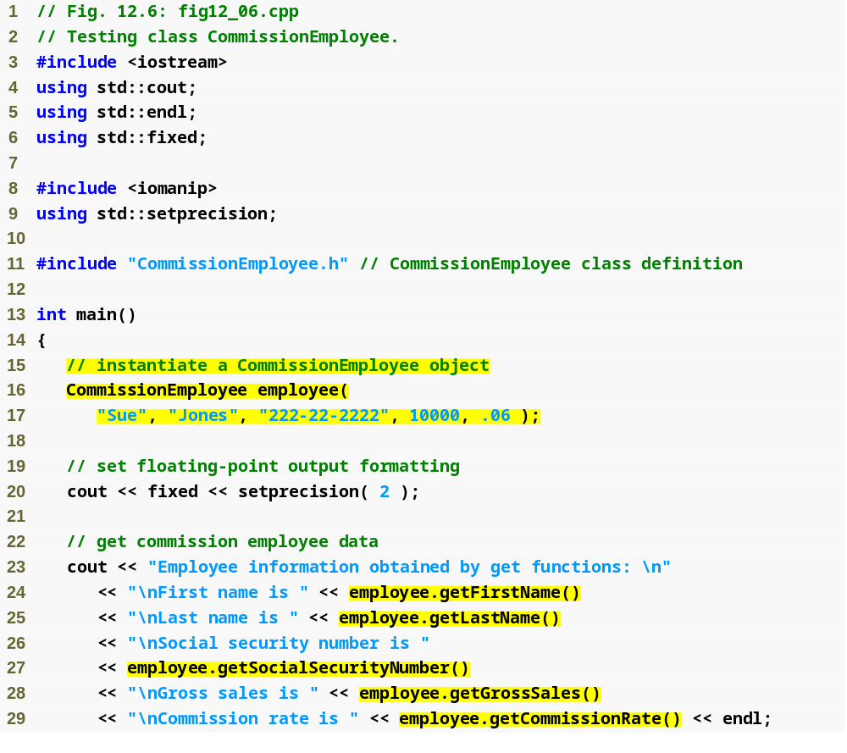
Outline
fig12_06.cpp
(1 of 2)
Instantiate CommissionEmployee object
Use CommissionEmployee’s get functions to retrieve the object’s instance variable values

Slide 19
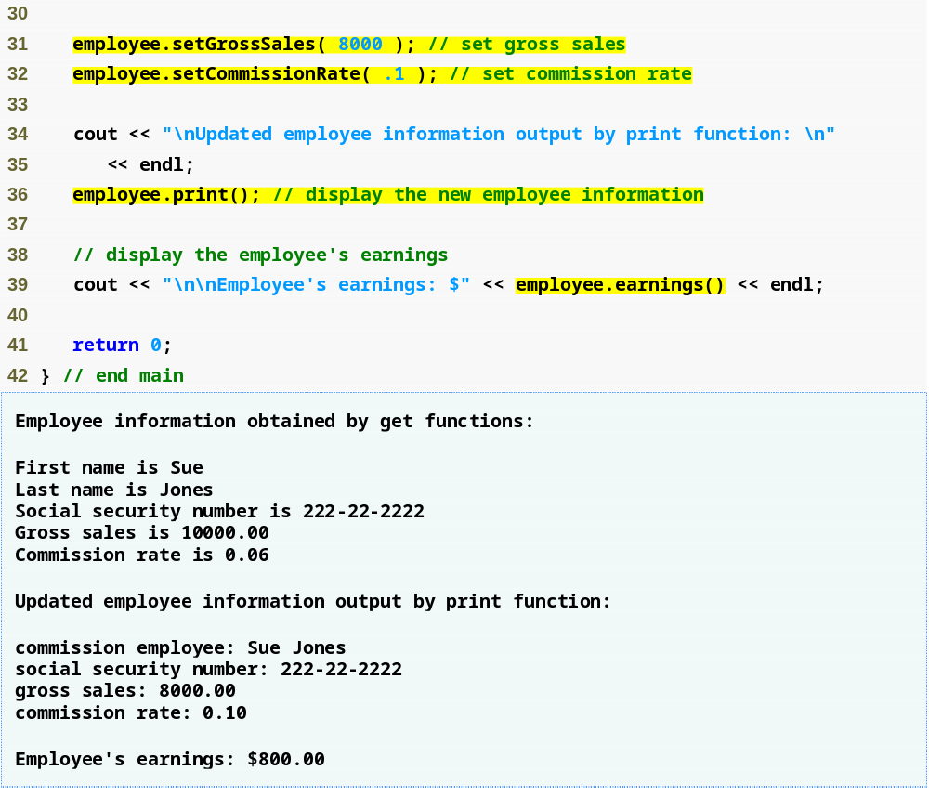
Outline
Use CommissionEmployee’s set functions to change the object’s instance variable values
fig12_06.cpp
(2 of 2)
Call object’s print function to display employee information
Call object’s earnings function to calculate earnings

Slide 20
12.4.2 Creating a BasePlusCommissionEmployee Class Without Using Inheritance
Class BasePlusCommissionEmployee
  Much of the code is similar to CommissionEmployee
    private data members
    public methods
    constructor
  Additions
    private data member baseSalary
    Methods setBaseSalary and getBaseSalary

Slide 21
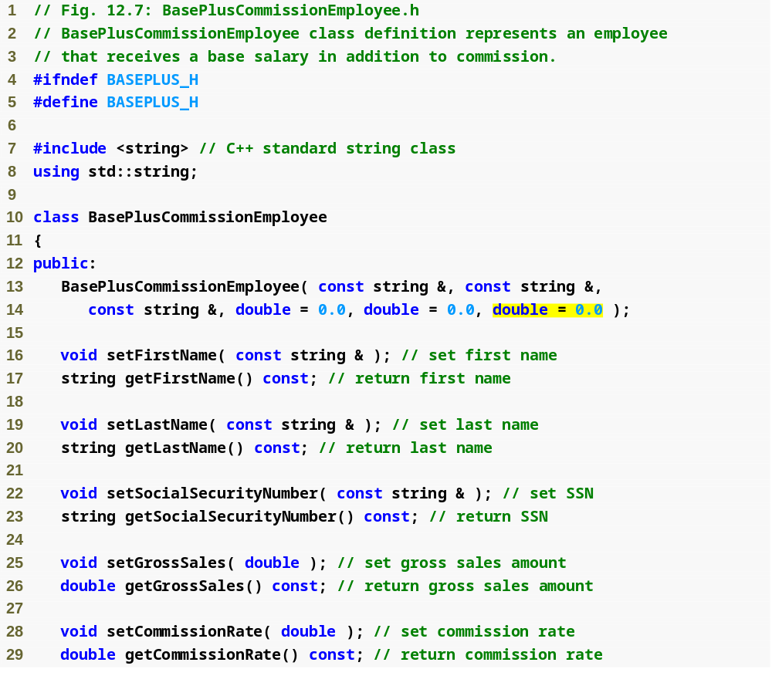
Outline
BasePlus
Commission
Employee.h
(1 of 2)
Constructor takes one more argument, which specifies the base salary

Slide 22
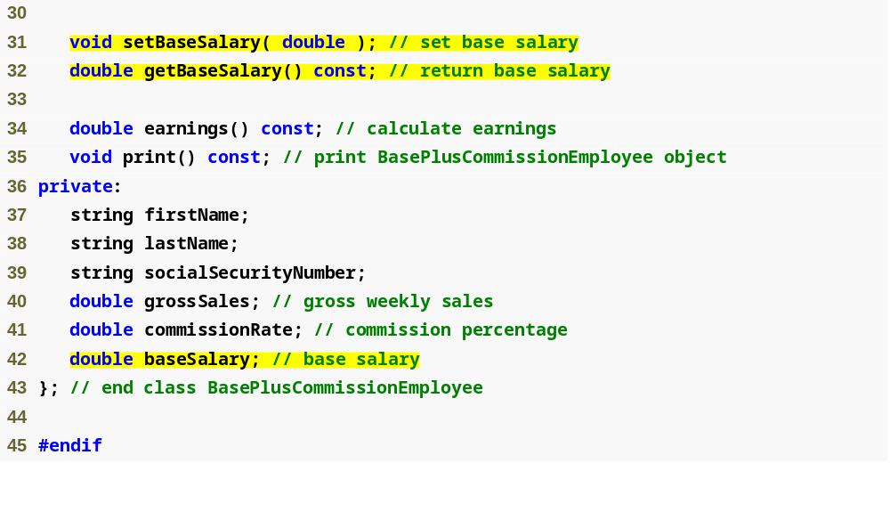
Define get and set functions for data member baseSalary
Outline
BasePlus
Commission
Employee.h
(2 of 2)
Add data member baseSalary

Slide 23
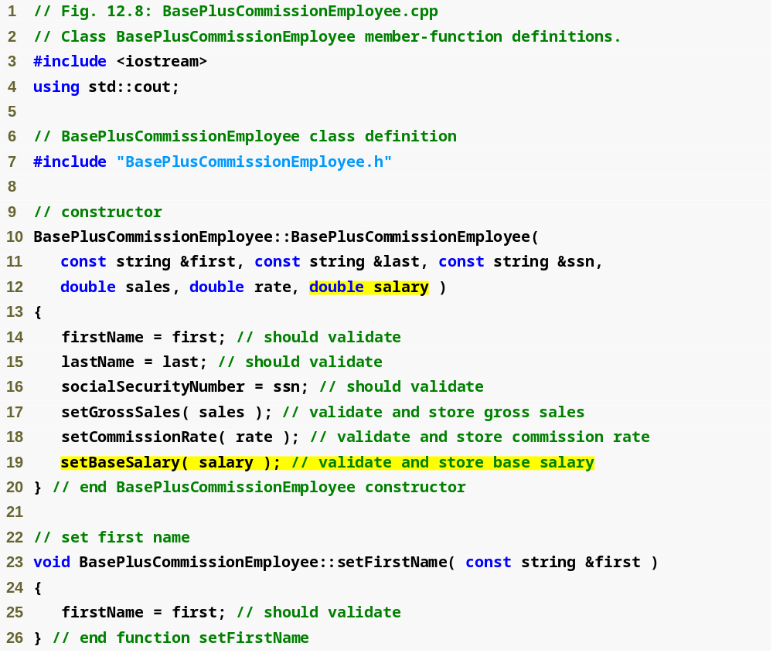
Outline
BasePlus
Commission
Employee.cpp
(1 of 4)
Constructor takes one more argument, which specifies the base salary
Use function setBaseSalary to validate data

Slide 24
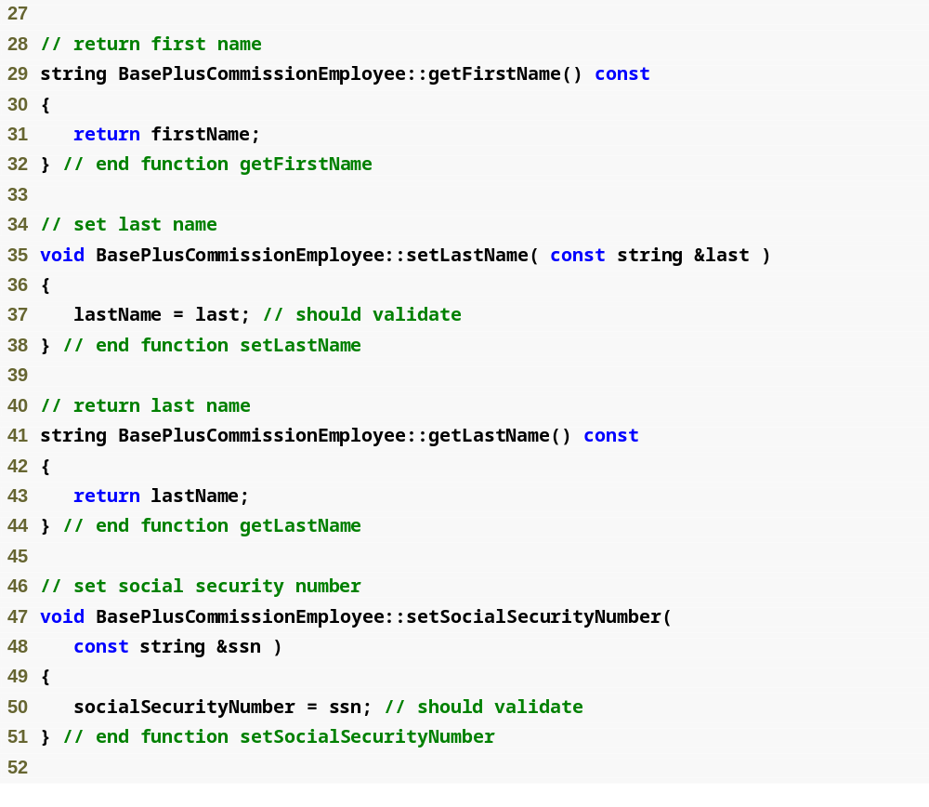
Outline
BasePlus
Commission
Employee.cpp
(2 of 4)

Slide 25
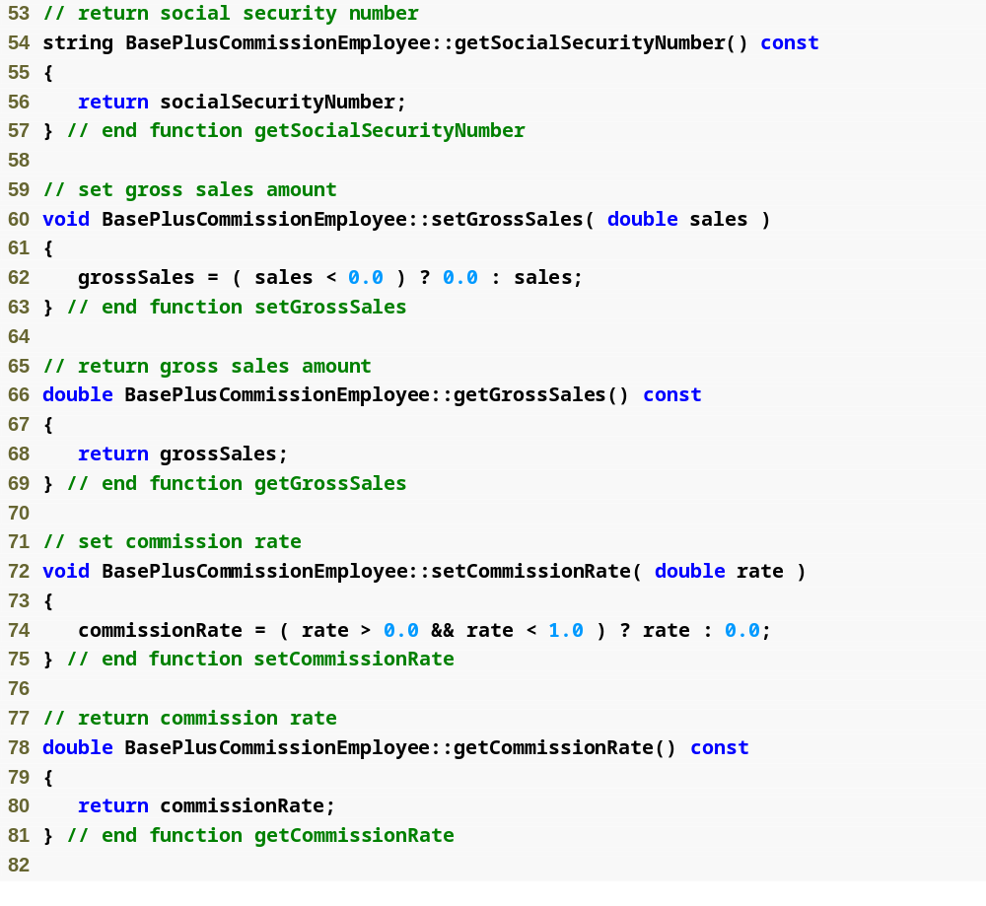
Outline
BasePlus
Commission
Employee.cpp
(3 of 4)

Slide 26
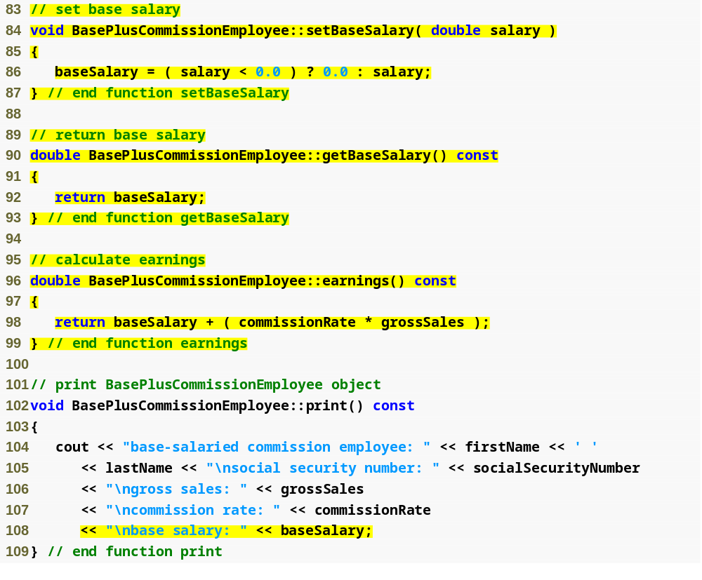
Outline
Function setBaseSalary validates data and sets instance variable baseSalary
BasePlus
Commission
Employee.cpp
(4 of 4)
Function getBaseSalary returns the value of instance variable baseSalary
Update function earnings to calculate the earnings of a base-salaried commission employee
Update function print to display base salary

Slide 27
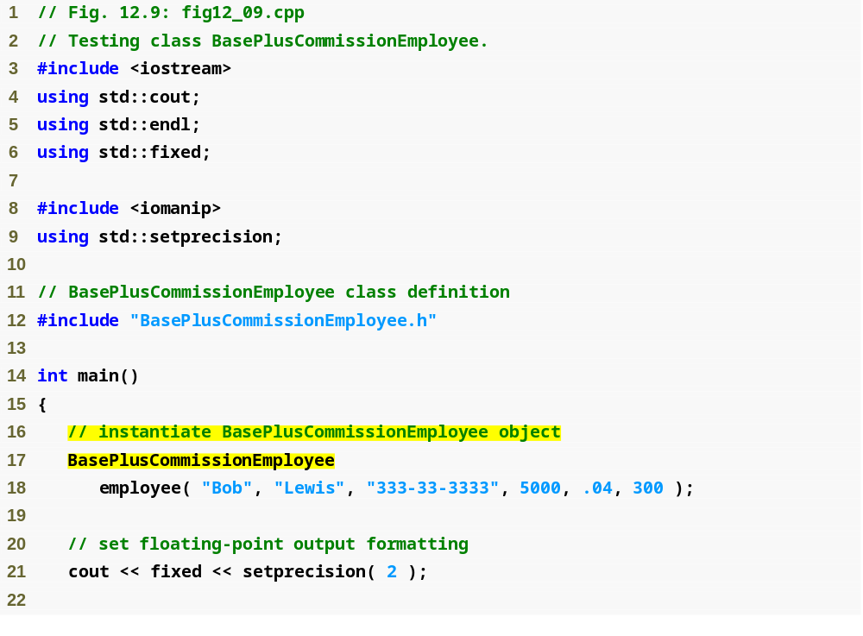
Outline
fig12_09.cpp
(1 of 3)
Instantiate BasePlusCommissionEmployee object

Slide 28
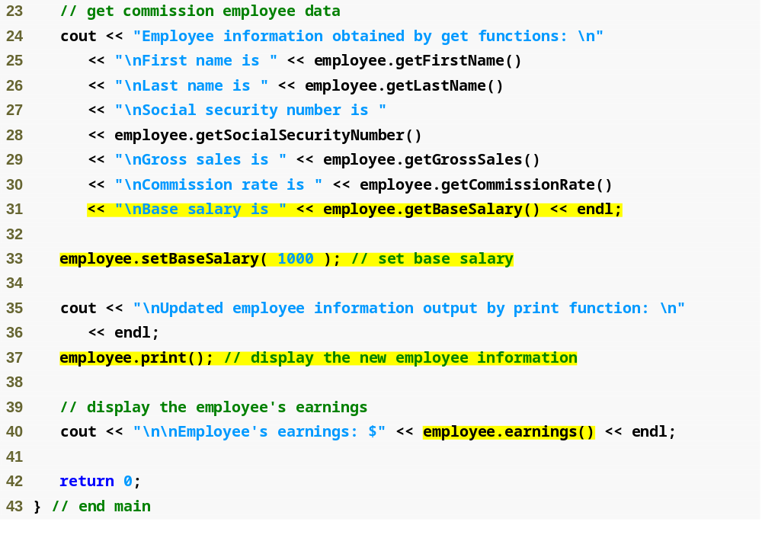
Outline
Use BasePlusCommissionEmployee’s get functions to retrieve the object’s instance variable values
fig12_09.cpp
(2 of 3)
Use BasePlusCommissionEmployee’s setBaseSalary function to set base salary
Call object’s print function to display employee information
Call object’s earnings function to calculate employee’s earnings

Slide 29
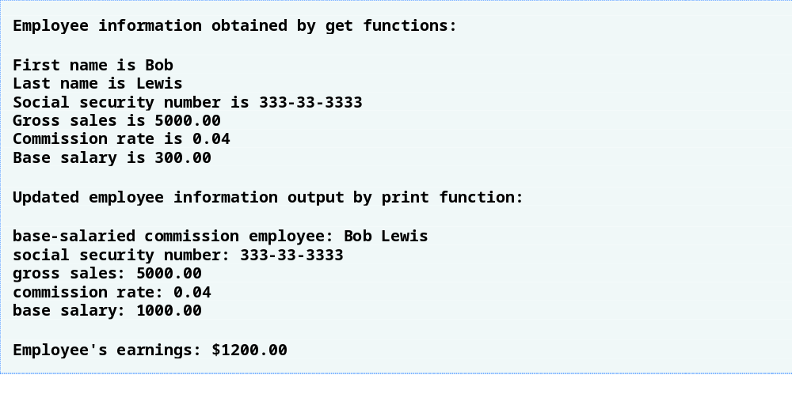
Outline
fig12_09.cpp
(3 of 3)

Slide 30
12.4.3 Creating a CommissionEmployee-BasePlusCommissionEmployee Inheritance Hierarchy
Class BasePlusCommissionEmployee
  Derived from class CommissionEmployee
    Is a CommissionEmployee
    Inherits all public members
  Constructor is not inherited
    Use base-class initializer syntax to initialize base-class data member
  Has data member baseSalary

Slide 31
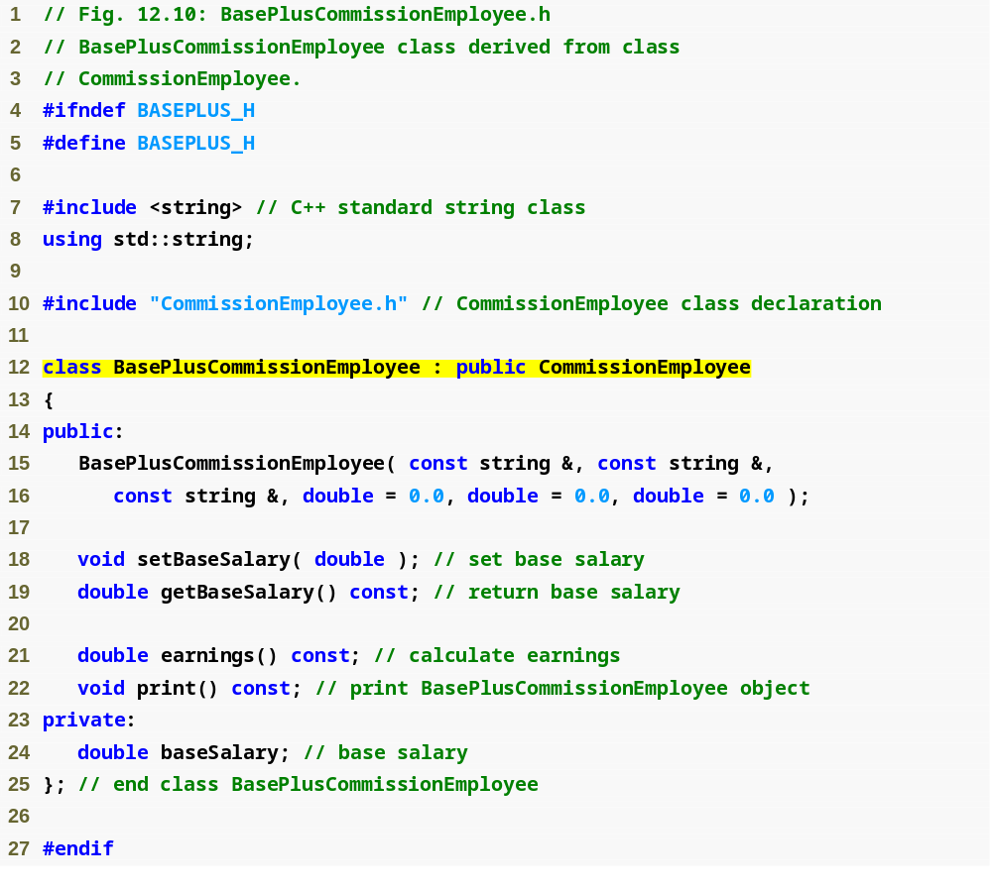
Outline
BasePlus
Commission
Employee.h
(1 of 1)
Include the base-class header file in the derived-class header file
Class BasePlusCommissionEmployee derives publicly from class CommissionEmployee

Slide 32
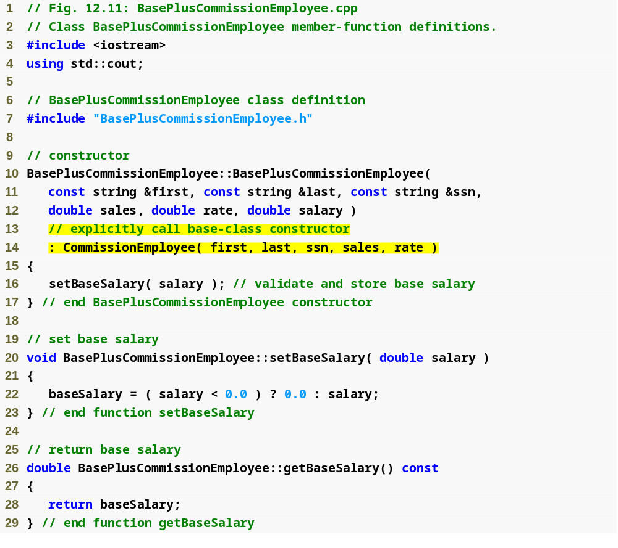
Outline
BasePlus
Commission
Employee.cpp
(1 of 4)
Initialize base class data member by calling the base-class constructor using base-class initializer syntax

Slide 33
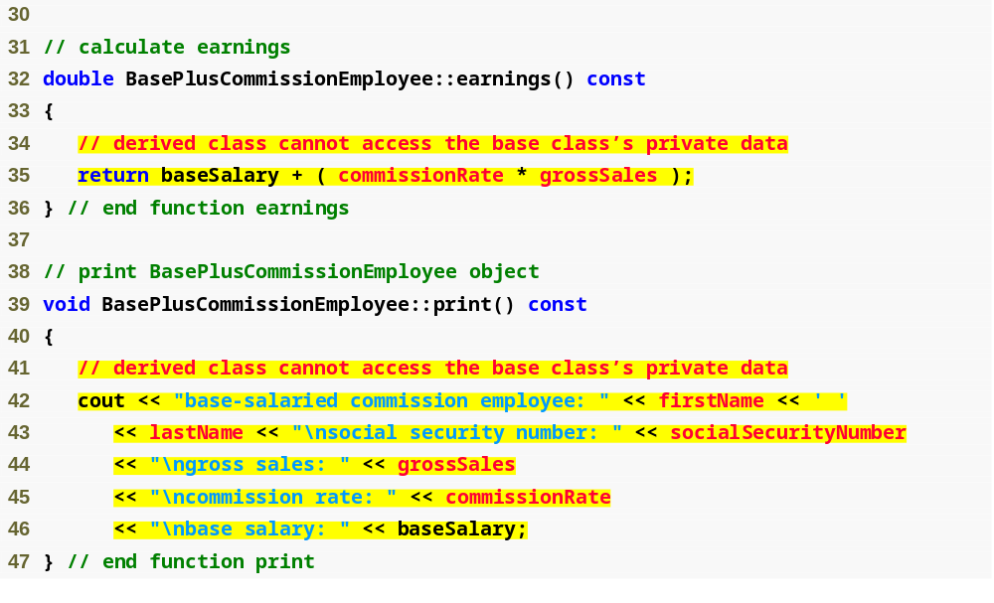
Outline
BasePlus
Commission
Employee.cpp
(2 of 4)
Compiler generates errors because base class’s data member commissionRate and grossSales are private
Compiler generates errors because the base class’s data members firstName, lastName, socialSecurityNumber, grossSales and commissionRate are private

Slide 34
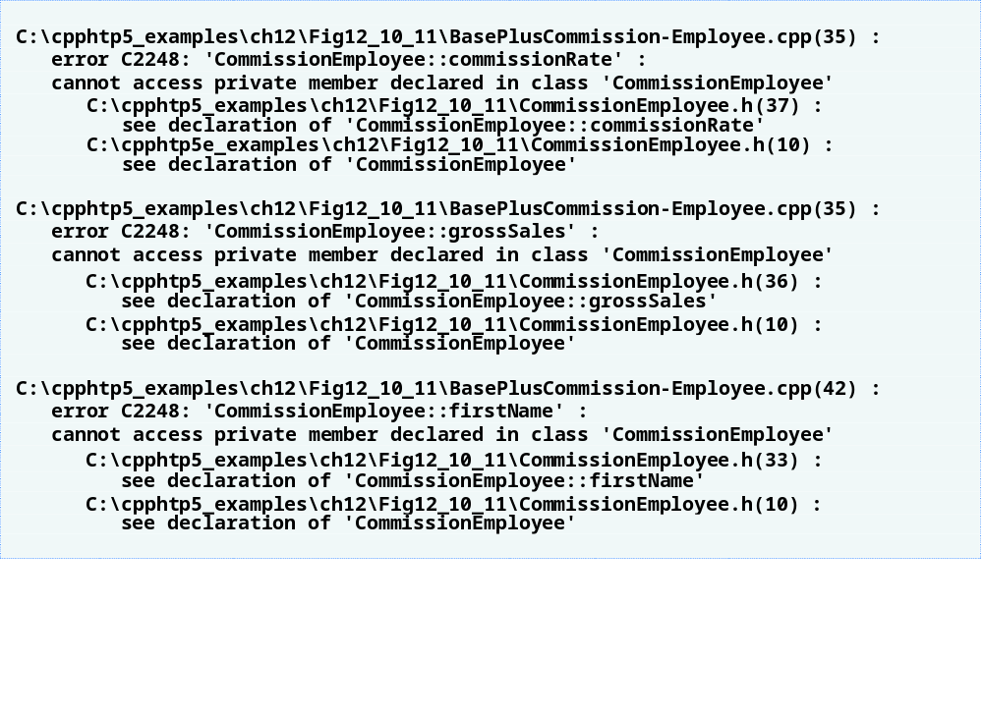
Outline
BasePlus
Commission
Employee.cpp
(3 of 4)

Slide 35
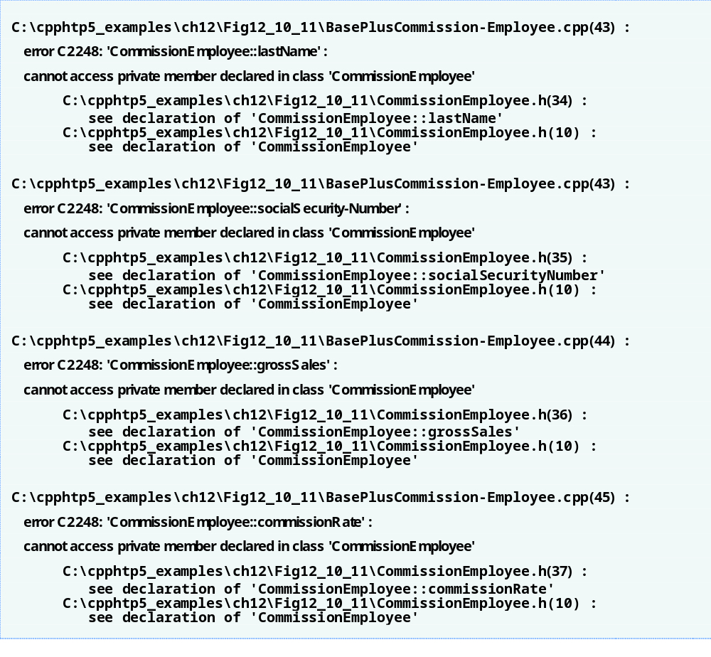
Outline
BasePlus
Commission
Employee.cpp
(4 of 4)

Slide 36
12.4.3 Creating a CommissionEmployee-BasePlusCommissionEmployee Inheritance Hierarchy (Cont.)
Including the base class header file
  Base class header file must be included in derived class header file for three reasons, the compiler must
    Know that base class exists
    Know size of inherited data members
    Ensure that inherited class members are used properly

Slide 37
12.4.4 CommissionEmployee-BasePlusCommissionEmployee Inheritance Hierarchy Using protected Data
Use protected data
  Enable class BasePlusCommissionEmployee to directly access base class data members
  Base class’s protected members are inherited by all derived classes of that base class

Slide 38
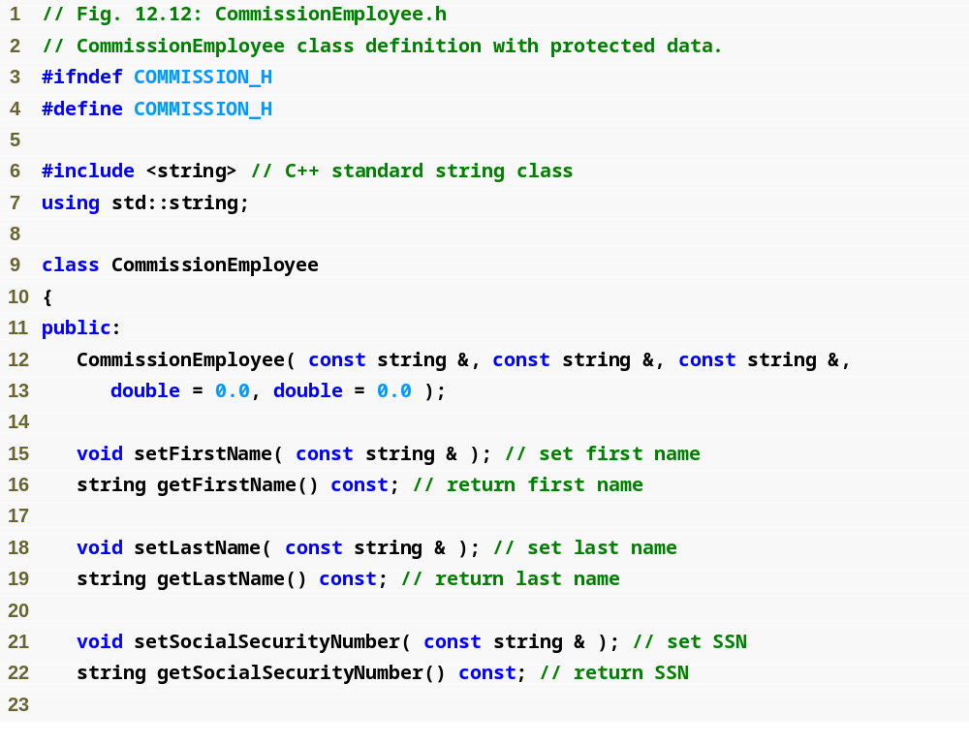
Outline
Commission
Employee.h
(1 of 2)

Slide 39
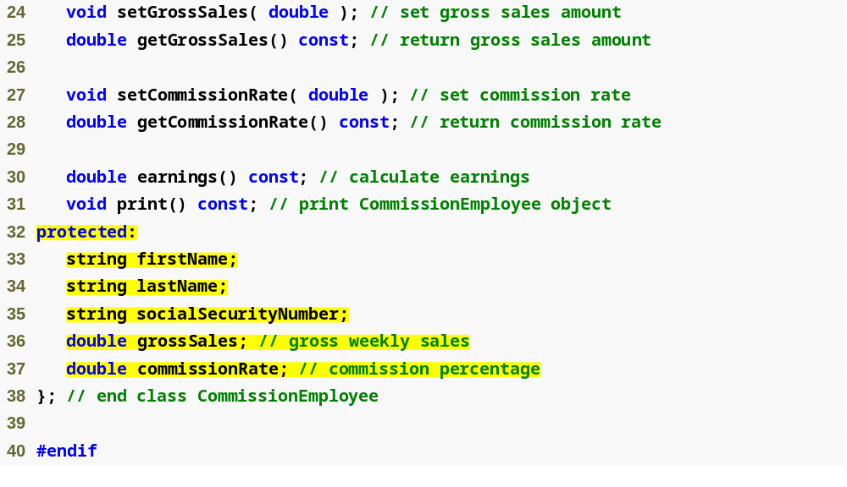
Outline
Commission
Employee.h
(2 of 2)
Declare protected data

Slide 40
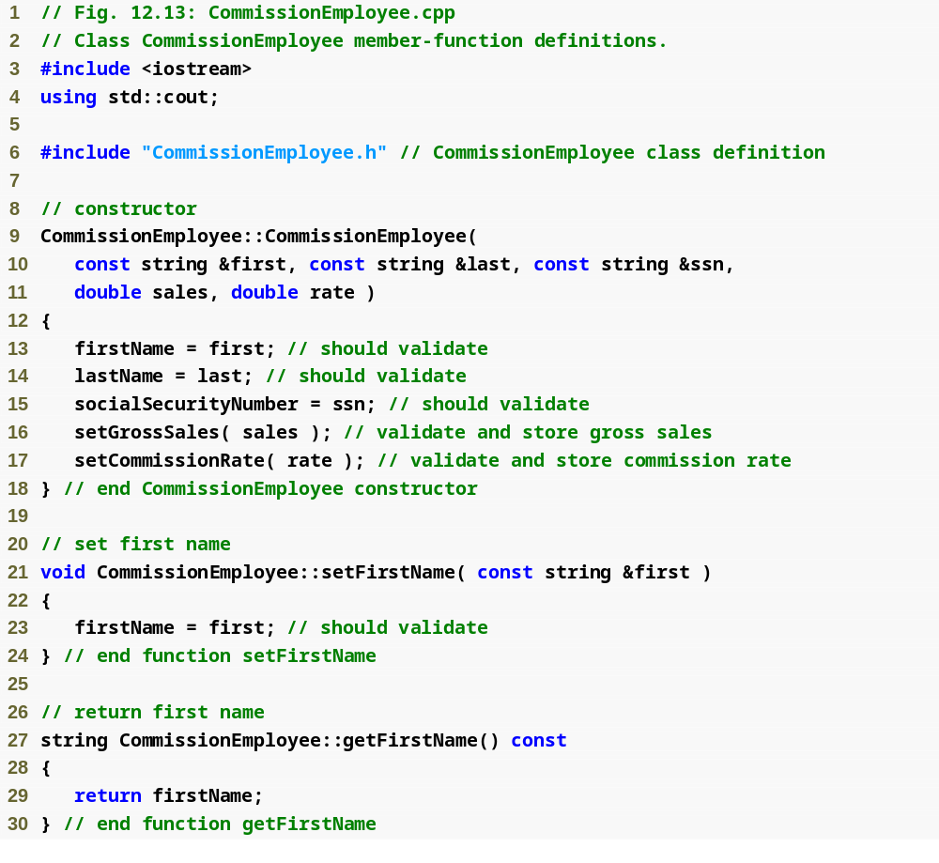
Outline
Commission
Employee.cpp
(1 of 4)

Slide 41
Outline
Commission
Employee.cpp
(2 of 4)

Slide 42
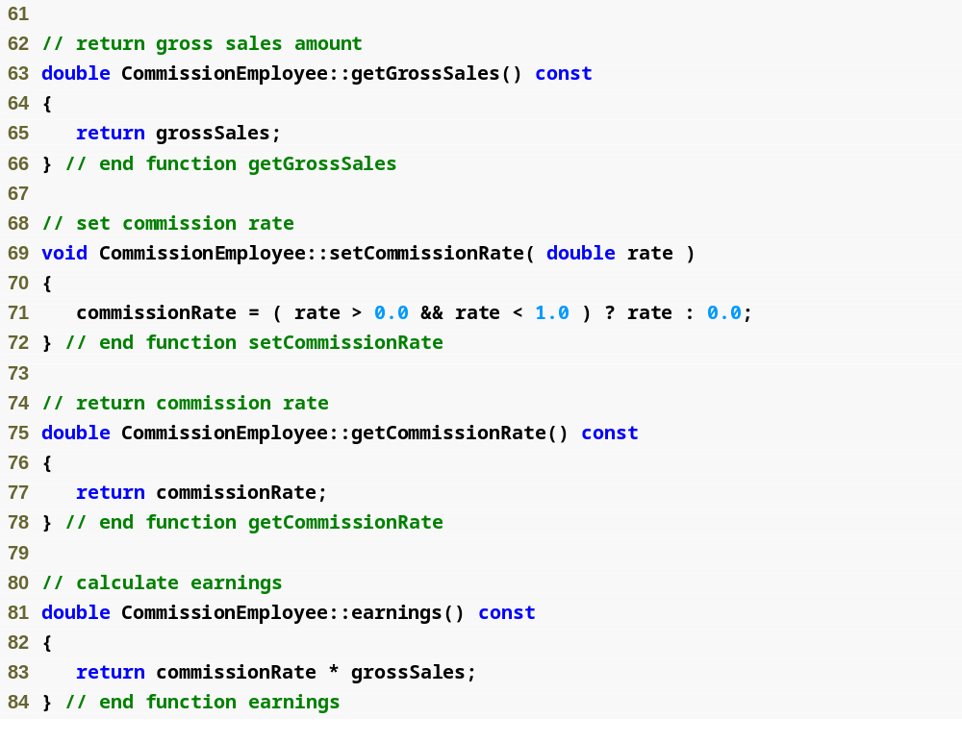
Outline
Commission
Employee.cpp
(3 of 4)

Slide 43
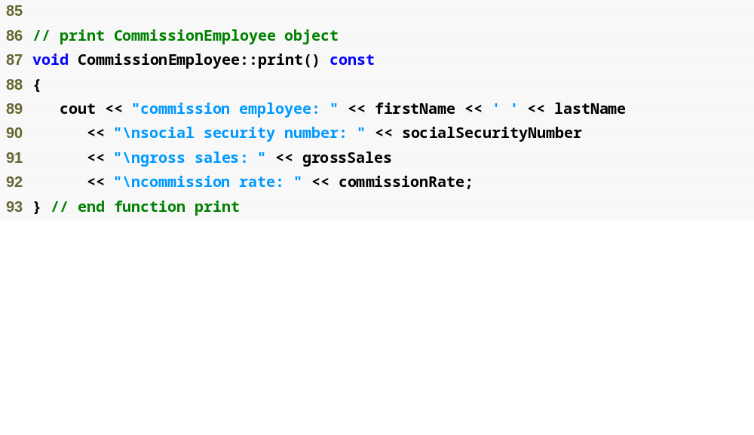
Outline
Commission
Employee.cpp
(4 of 4)

Slide 44
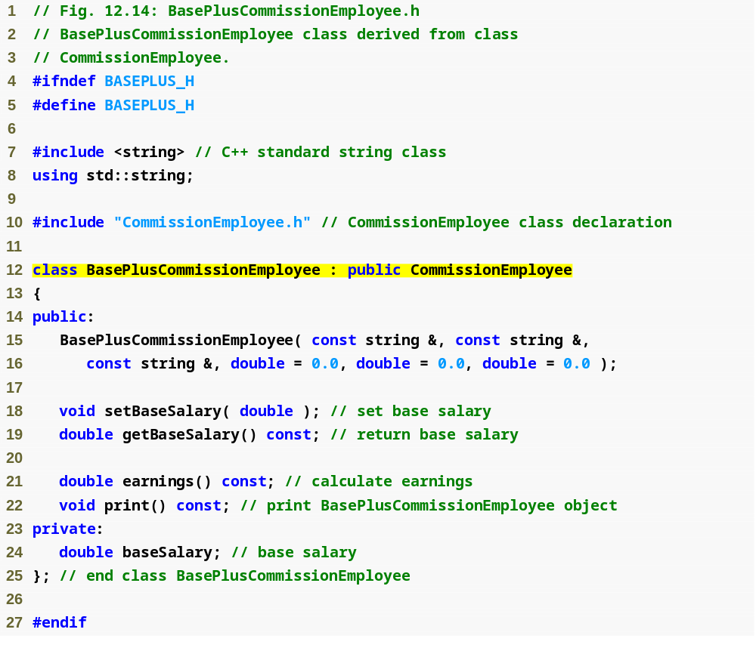
Outline
BasePlus
Commission
Employee.h
(1 of 1)
BasePlusCommissionEmployee still inherits publicly from CommissionEmployee

Slide 45

Outline
BasePlus
Commission
Employee.cpp
(1 of 2)
Call base-class constructor using base-class initializer syntax

Slide 46
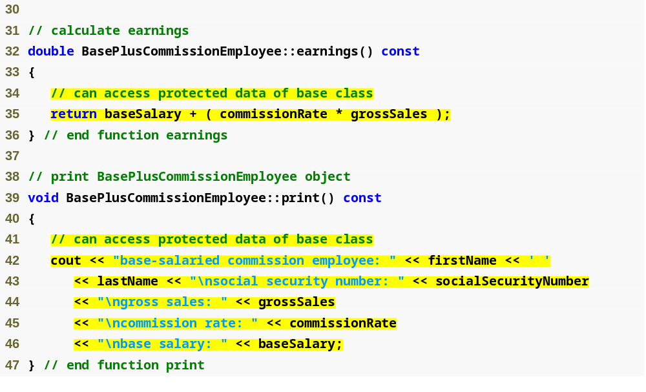
Outline
BasePlus
Commission
Employee.cpp
(2 of 2)
Directly access base class’s protected data

Slide 47

Outline
Fig12_16.cpp
(1 of 3)

Slide 48

Outline
Fig12_16.cpp
(2 of 3)

Slide 49
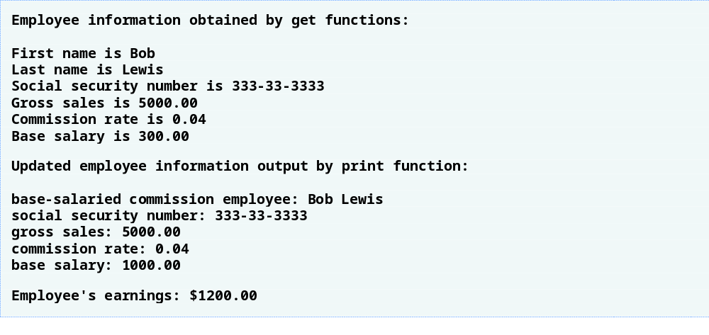
Outline
Fig12_16.cpp
(3 of 3)

Slide 50
12.4.4 CommissionEmployee-BasePlusCommissionEmployee Inheritance Hierarchy Using protected Data (Cont.)
Using protected data members
  Advantages
    Derived class can modify values directly
      Avoid set/get method call overhead
        Slight increase in performance
  Disadvantages
    No validity checking
      Derived class can assign illegal value
    Implementation dependent
      Derived class functions more likely dependent on base class implementation
      Base class implementation changes may result in derived class modifications
        Fragile (brittle) software

Slide 51
12.4.5 CommissionEmployee-BasePlusCommissionEmployee Inheritance Hierarchy Using private Data
Reexamine hierarchy
  Use the best software engineering practice
    Declare data members as private
    Provide public get and set functions
    Use get method to obtain values of data members

Slide 52
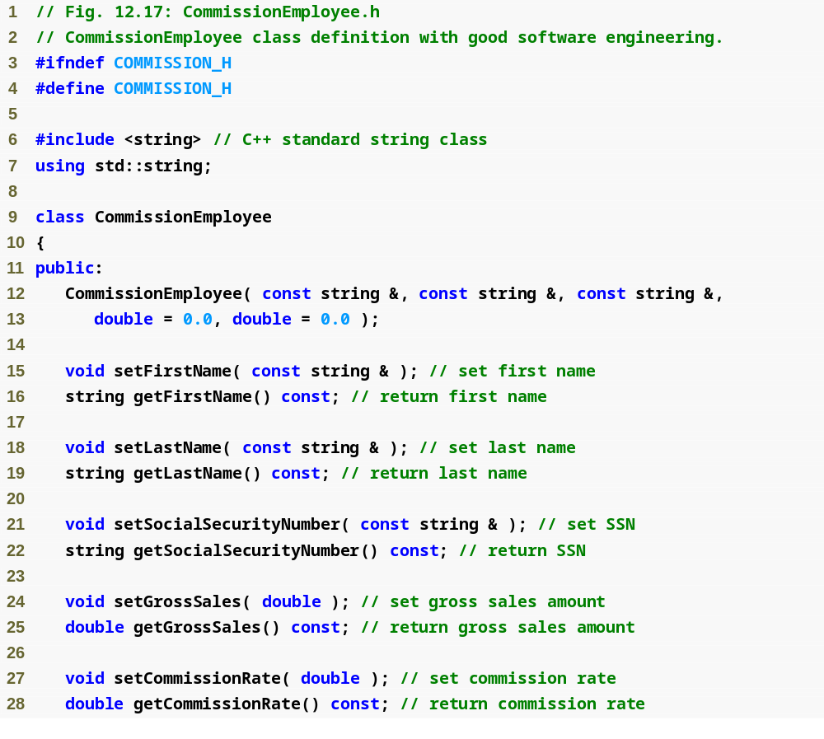
Outline
Commission
Employee.h
(1 of 2)

Slide 53
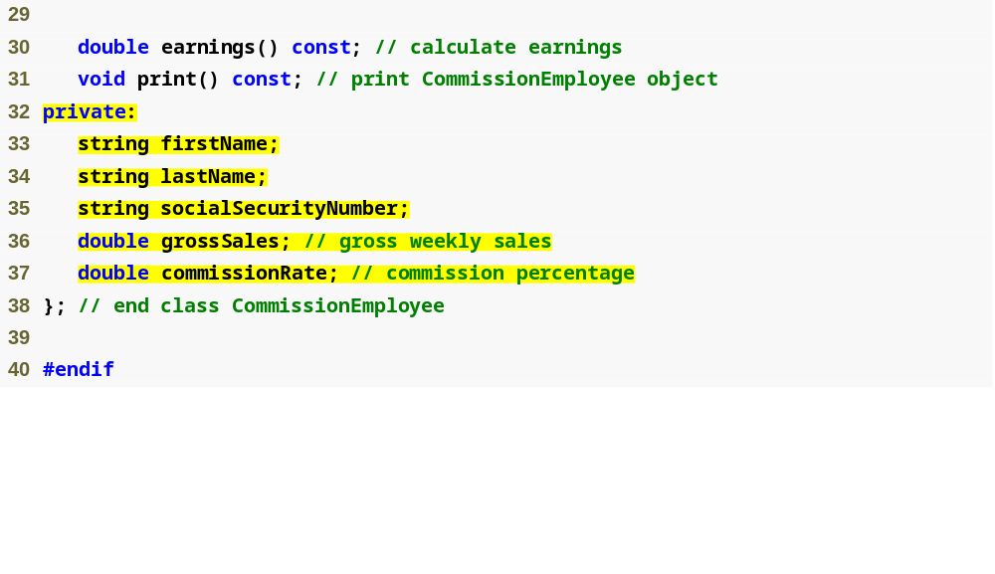
Outline
Declare private data
Commission
Employee.h
(2 of 2)

Slide 54
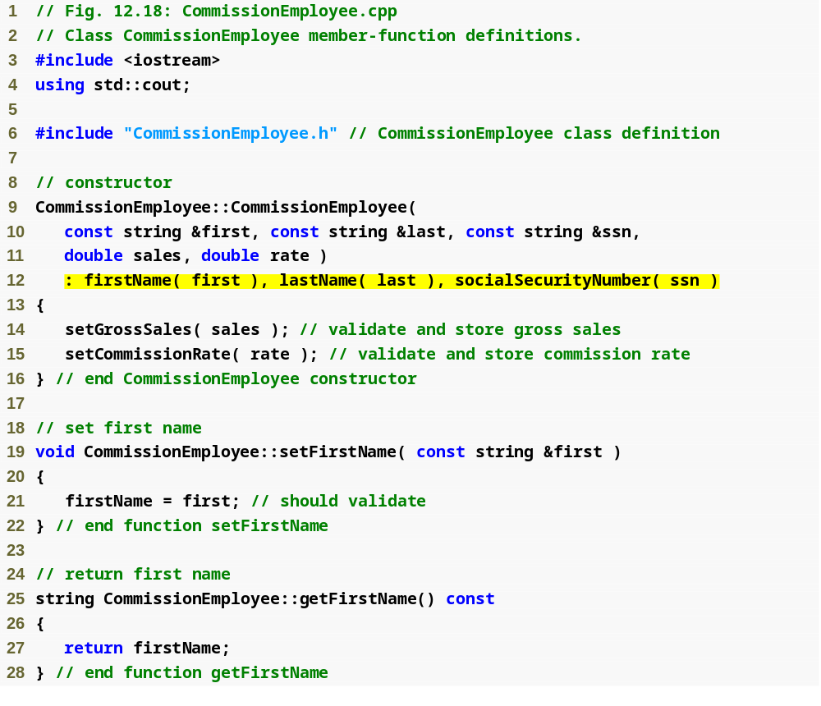
Outline
Commission
Employee.cpp
(1 of 4)
Use member initializers to set the values of members firstName, lastname and socialSecurityNumber

Slide 55
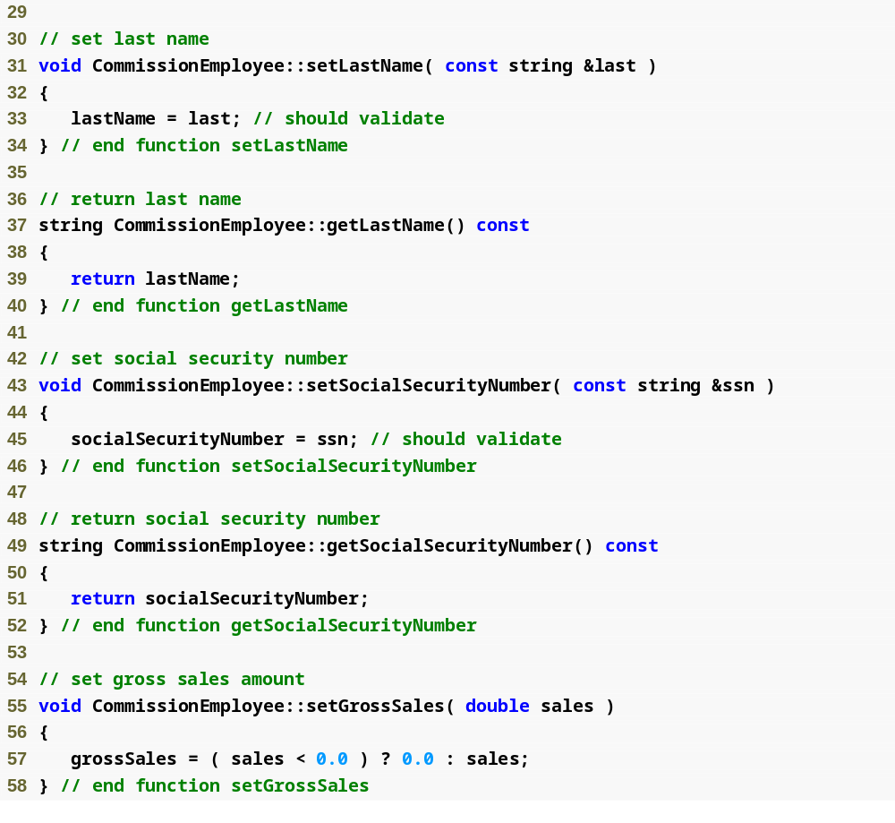
Outline
Commission
Employee.cpp
(2 of 4)

Slide 56
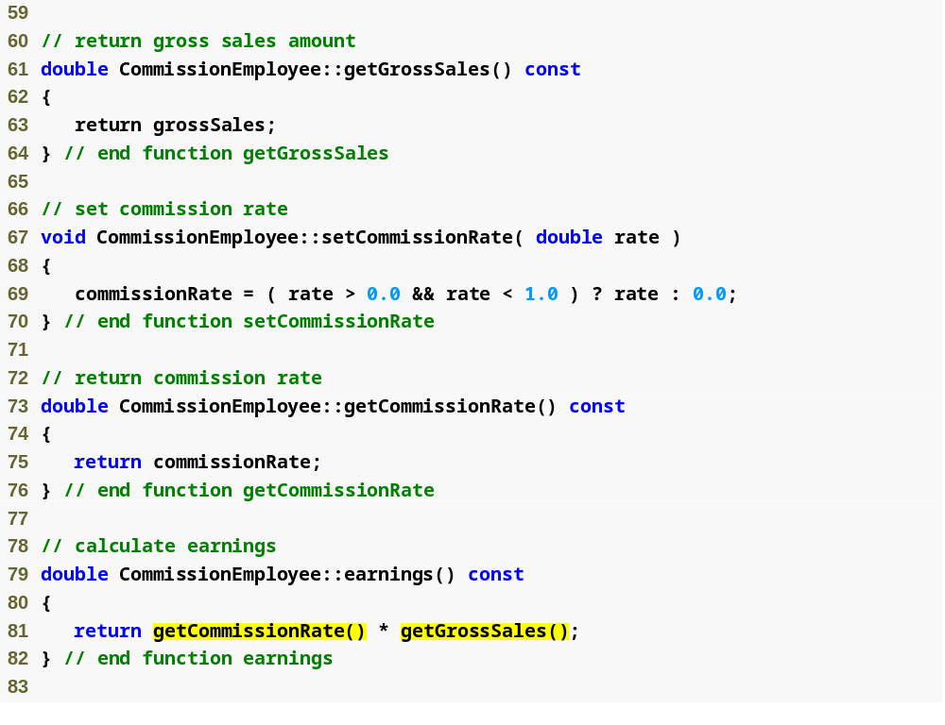
Outline
Commission
Employee.cpp
(3 of 4)
Use get functions to obtain the values of data members

Slide 57
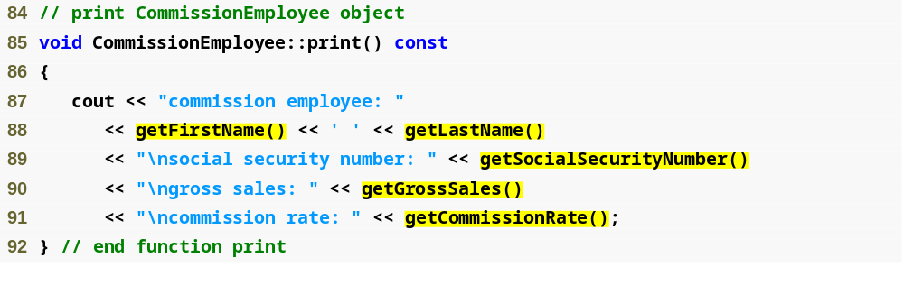
Outline
Commission
Employee.cpp
(4 of 4)
Use get functions to obtain the values of data members

Slide 58

Outline
BasePlus
Commission
Employee.h
(1 of 1)

Slide 59
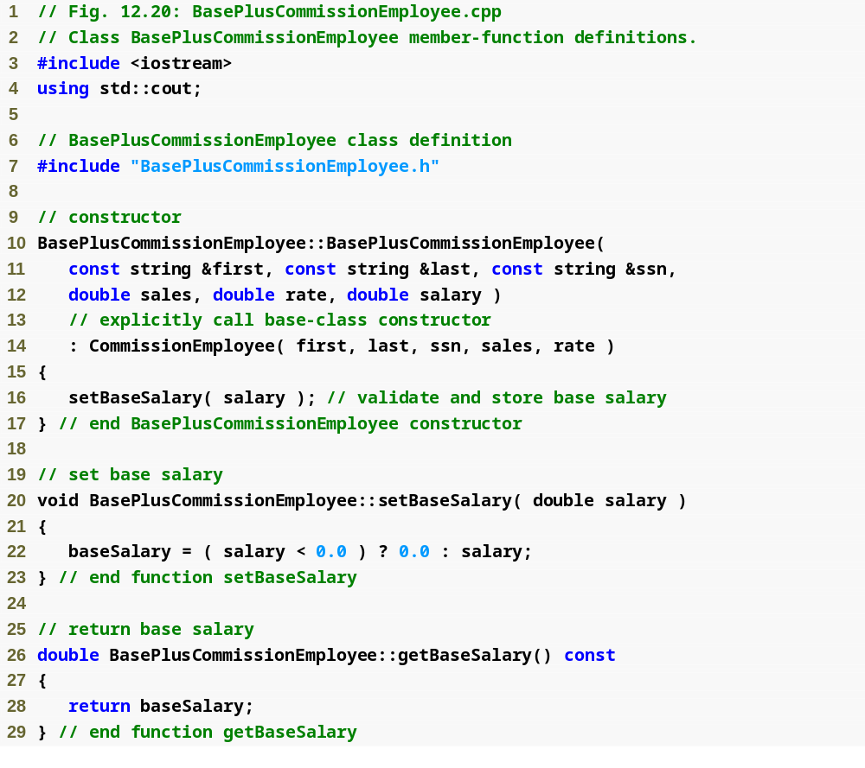
Outline
BasePlus
Commission
Employee.cpp
(1 of 2)

Slide 60
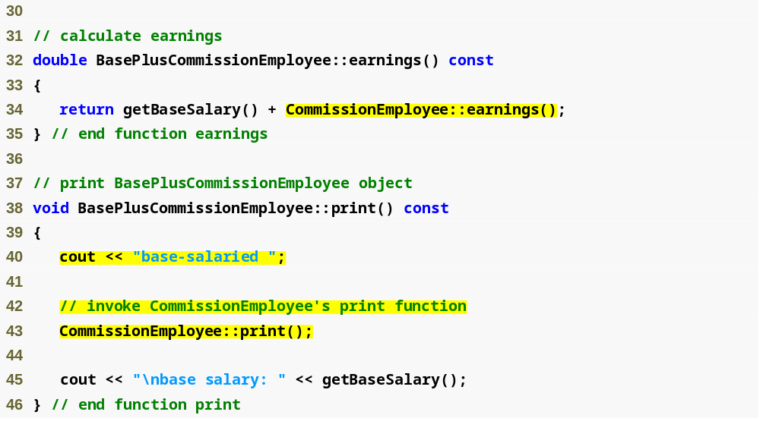
Outline
BasePlus
Commission
Employee.cpp
(2 of 2)
Invoke base class’s earnings function
Invoke base class’s print function

Slide 61
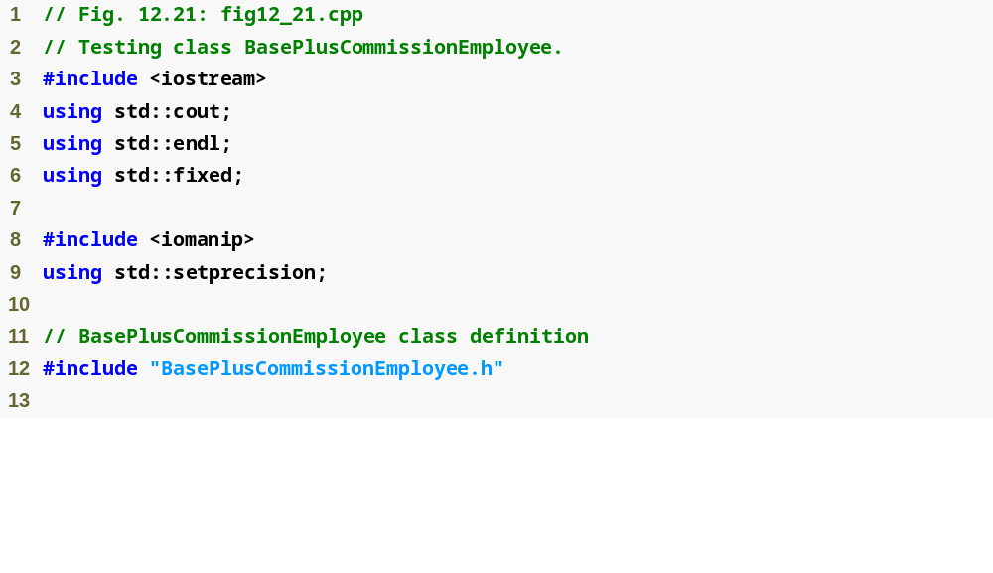
Outline
fig12_21.cpp
(1 of 3)

Slide 62
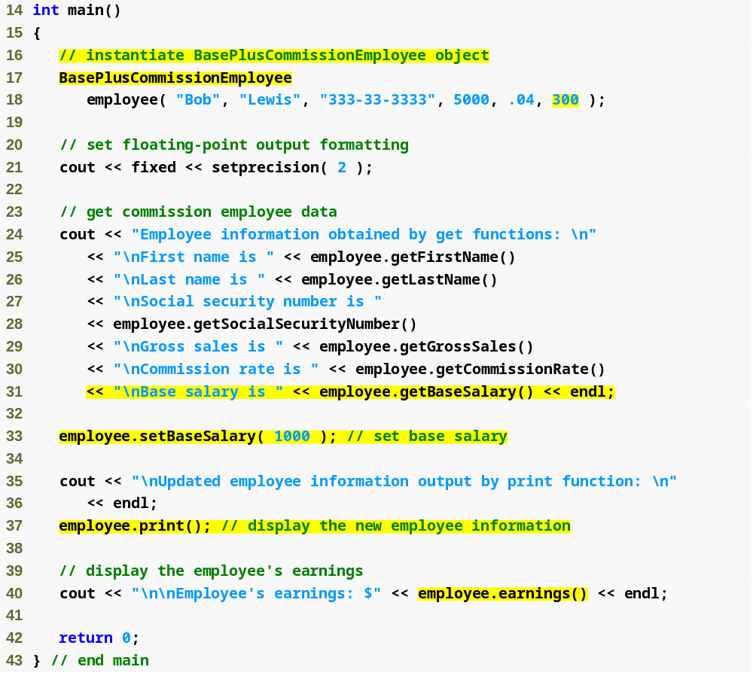
Outline
fig12_21.cpp
(2 of 3)
Create BasePlusCommissionEmployee object
Use inherited get methods to access base class private members
Use BasePlusCommissionEmployee get method to access private member
Use BasePlusCommissionEmployee set method to modify private data member baseSalary

Slide 63
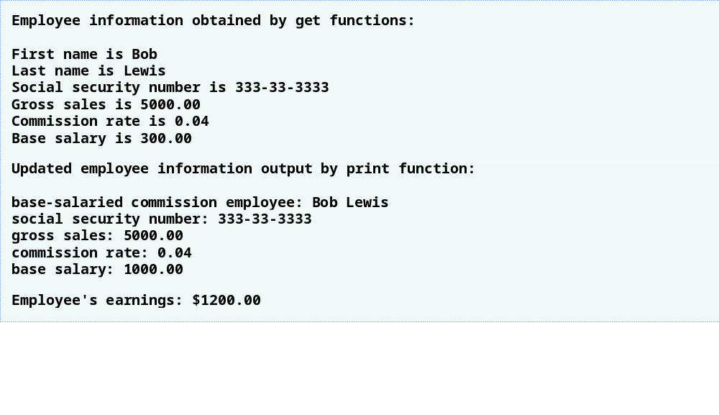
Outline
fig12_21.cpp
(3 of 3)

Slide 64
12.5 Constructors and Destructors in Derived Classes
Instantiating derived-class object
  Chain of constructor calls
    Derived-class constructor invokes base class constructor
      Implicitly or explicitly
    Base of inheritance hierarchy
      Last constructor called in chain
      First constructor body to finish executing
      Example: CommissionEmployee/BasePlusCommissionEmployee hierarchy
        CommissionEmployee constructor called last
        CommissionEmployee constructor body finishes execution first
    Initializing data members
      Each base-class constructor initializes its data members that are inherited by derived class

Slide 65
12.5 Constructors and Destructors in Derived Classes (Cont.)
Destroying derived-class object
  Chain of destructor calls
    Reverse order of constructor chain
    Destructor of derived-class called first
    Destructor of next base class up hierarchy next
      Continue up hierarchy until final base reached
        After final base-class destructor, object removed from memory
Base-class constructors, destructors, assignment operators
  Not inherited by derived classes

Slide 66
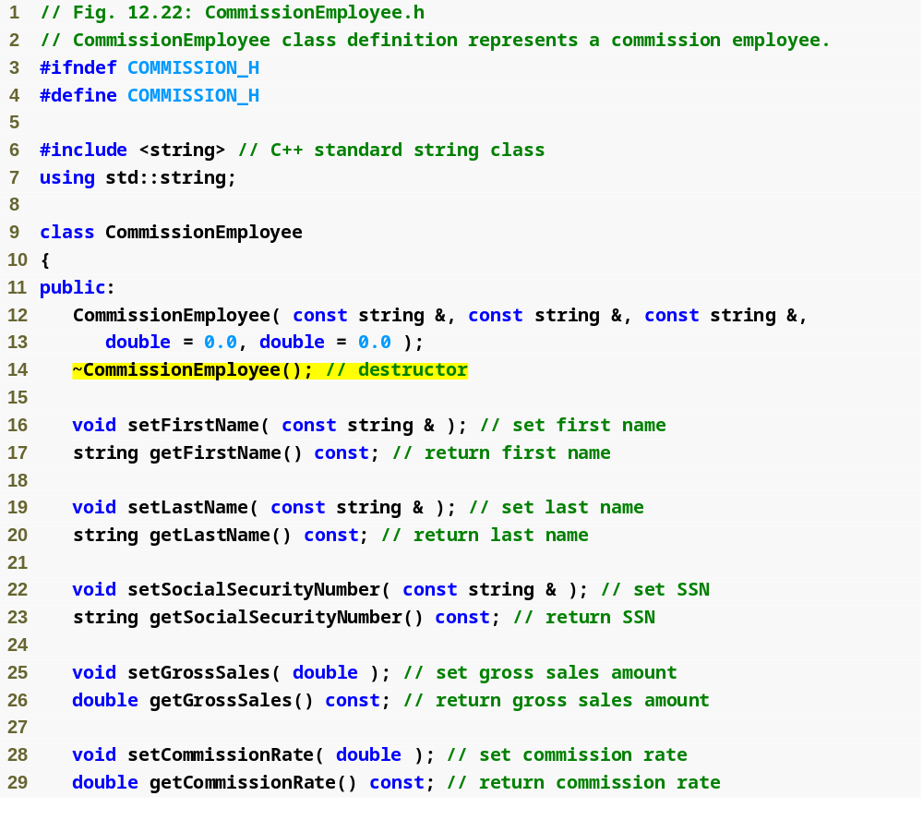
Outline
Commission
Employee.h
(1 of 2)
CommissionEmployee destructor

Slide 67
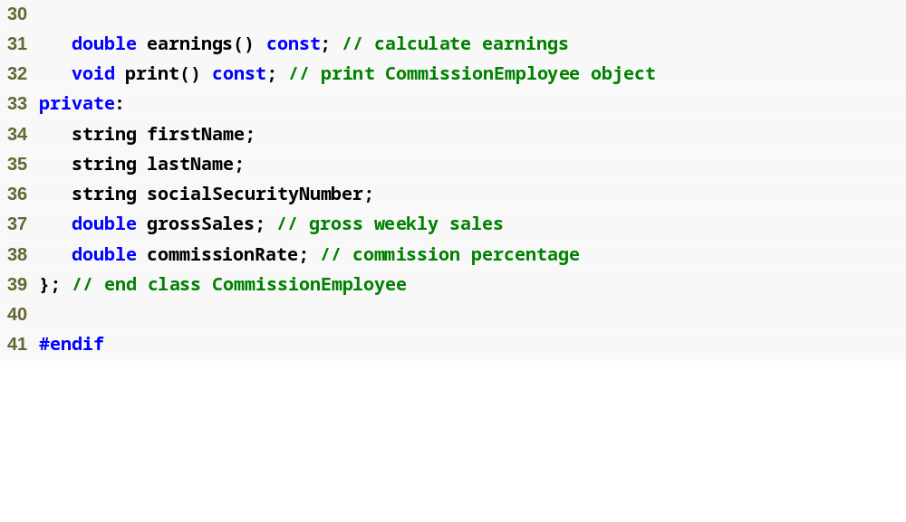
Outline
Commission
Employee.h
(2 of 2)

Slide 68
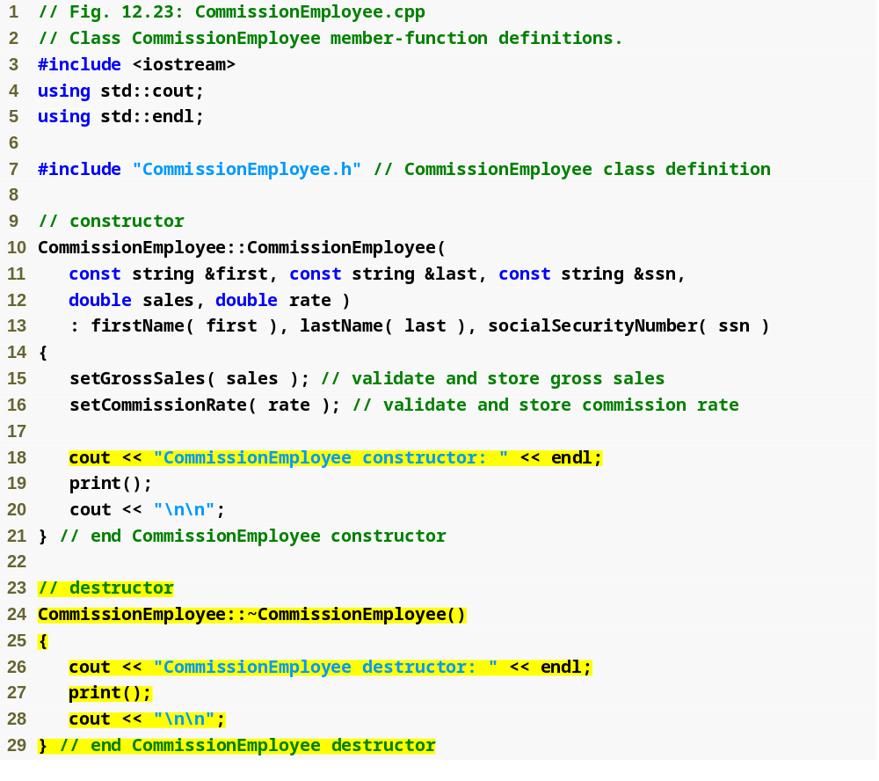
Outline
Commission
Employee.cpp
(1 of 4)
Constructor and destructor output messages to demonstrate function call order

Slide 69
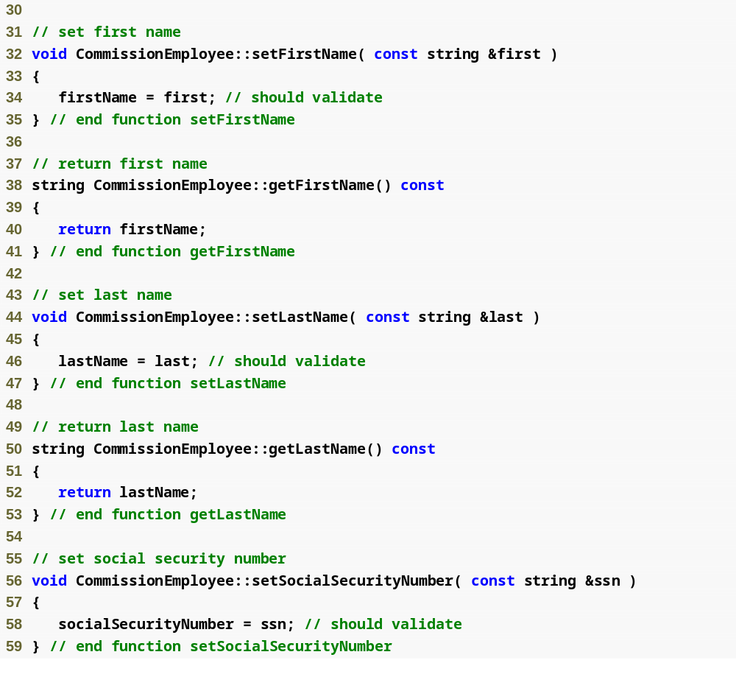
Outline
Commission
Employee.cpp
(2 of 4)

Slide 70
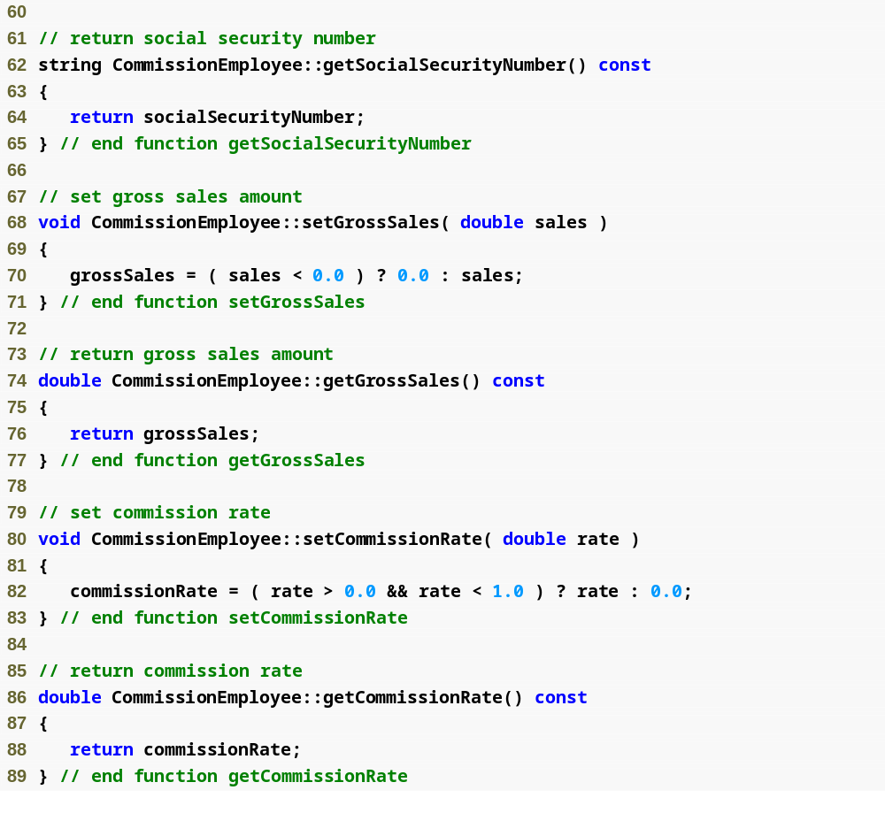
Outline
Commission
Employee.cpp
(3 of 4)

Slide 71
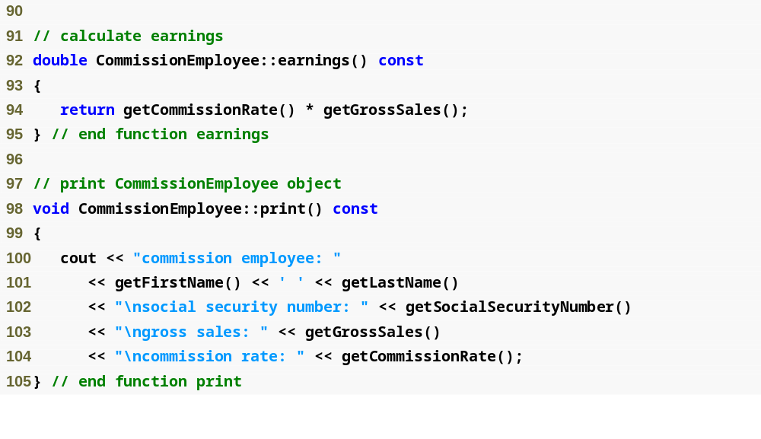
Outline
Commission
Employee.cpp
(4 of 4)

Slide 72

Outline
BasePlus
Commission
Employee.h
(1 of 1)
BasePlusCommissionEmployee destructor

Slide 73

Outline
BasePlus
Commission
Employee.cpp
(1 of 2)
Constructor and destructor output messages to demonstrate function call order

Slide 74

Outline
BasePlus
Commission
Employee.cpp
(2 of 2)

Slide 75

Outline
fig12_26.cpp
(1 of 4)

Slide 76

Outline
CommissionEmployee object goes in and out of scope immediately
fig12_26.cpp
(2 of 4)
Instantiate two BasePlusCommissionEmployee objects to demonstrate order of derived-class and base-class constructor/destructor function calls

Slide 77

Outline
fig12_26.cpp
(3 of 4)
CommissionEmployee constructor called for object in block; destructor called immediately as execution leaves scope
Base-class CommissionEmployee constructor executes first when instantiating derived-class BasePlusCommissionEmployee object
Derived-class BasePlusCommissionEmployee constructor body executes after base-class CommissionEmployee’s constructor finishes execution
Base-class CommissionEmployee constructor executes first when instantiating derived-class BasePlusCommissionEmployee object

Slide 78

Outline
Derived-class BasePlusCommissionEmployee constructor body executes after base-class CommissionEmployee’s constructor finishes execution
fig12_26.cpp
(4 of 4)
Destructors for BasePlusCommissionEmployee object called in reverse order of constructors
Destructors for BasePlusCommissionEmployee object called in reverse order of constructors

Slide 79

Fig. 12.27 | Summary of base-class member accessibility in a derived class.

